Slide 1
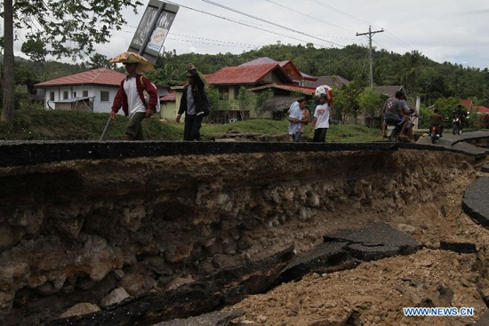

Slide 8
QUARTER 2 EARTHQUAKES AND FAULTS
Why do earthquakes occur?
What is the relationship between earthquakes and faults?

Slide 9
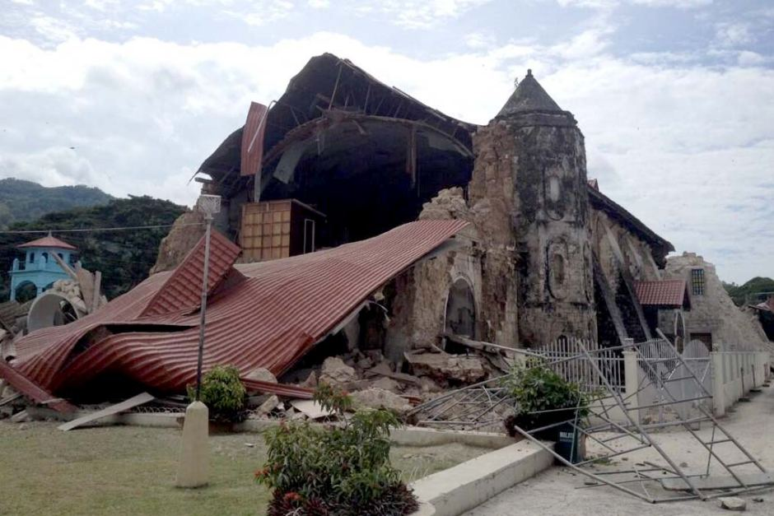
A shallow MAGNITUDE 7.2 earthquake struck Central Visayas Tuesday, October 15. The quake struck at 8:12 am, with EPICENTER 2 kilometers southeast of Carmen, Bohol. The quake's depth of FOCUS was 33 kilometers. According to scientists, the earthquake was caused by movement along the North Bohol Fault.

Slide 10
Earthquakes are associated with faults. When a fault suddenly moves, an earthquake occurs. Do you know what a fault is? Do the following activity to find out.

Slide 11
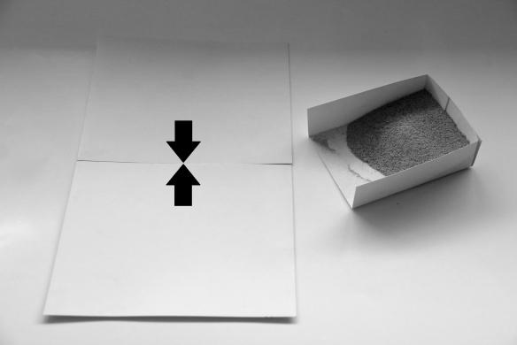
Activity 1
A fault-y setup

Slide 12
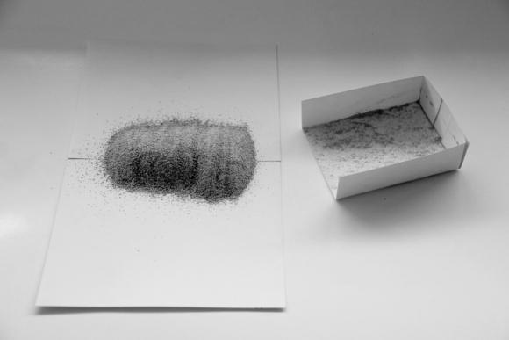

Slide 13
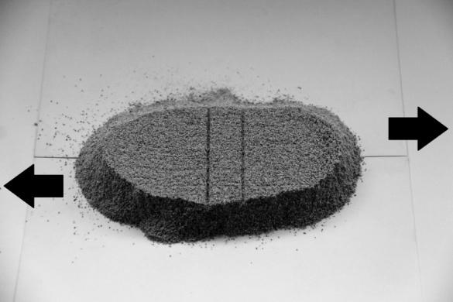

Slide 14
Activity 1: A fault-y setup
Q1. As you move the sheets, what is formed in the sand?
Q2. What happens to the lines?
Q3. Describe how a fault looks like.

Slide 15
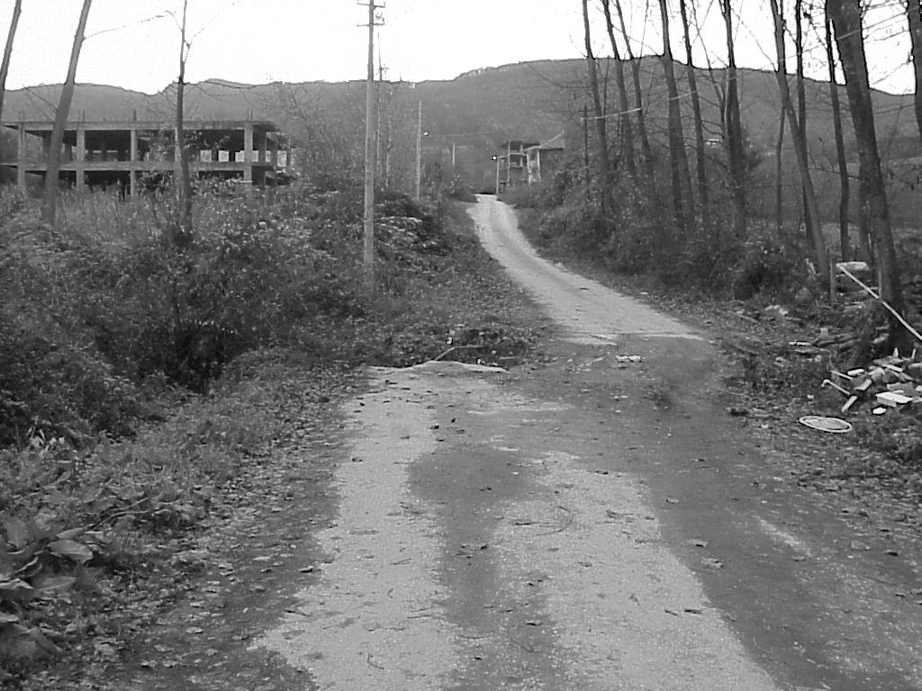

Slide 16
FAULT
A fault is a break in the Earth’s crust, and along the break, significant movement has taken place.

Slide 17
Quiz time!
Write T if the statement is correct and F if the statement is incorrect.
Fault is a break in the Earth’s crust.
Earthquakes and faults are not associated with each other.
Fault is where significant movement happens during earthquakes.
Philippines has faults surrounding the different regions
When a fault suddenly moves, earthquake happens.

Slide 18
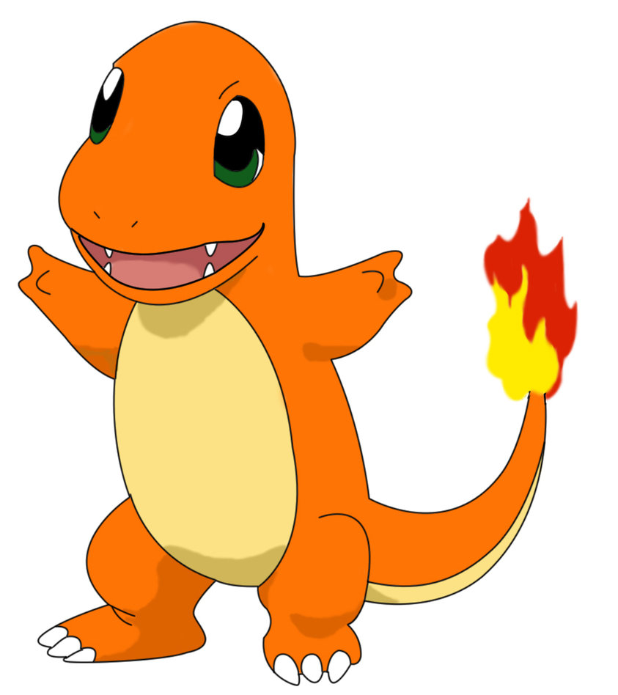
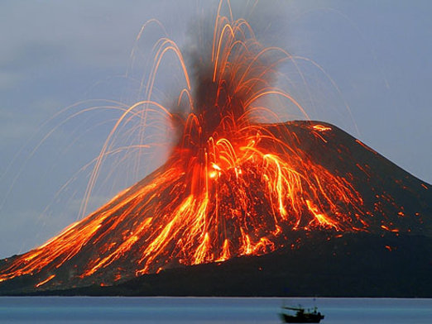

Slide 19
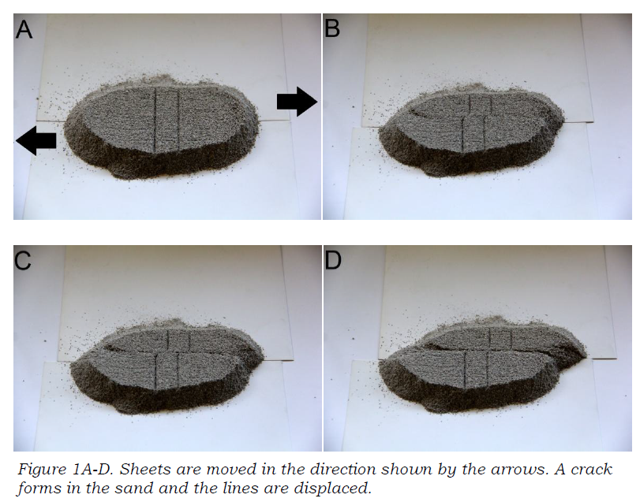

Slide 20
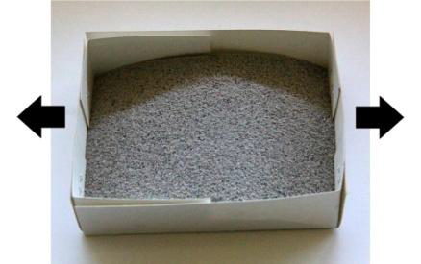
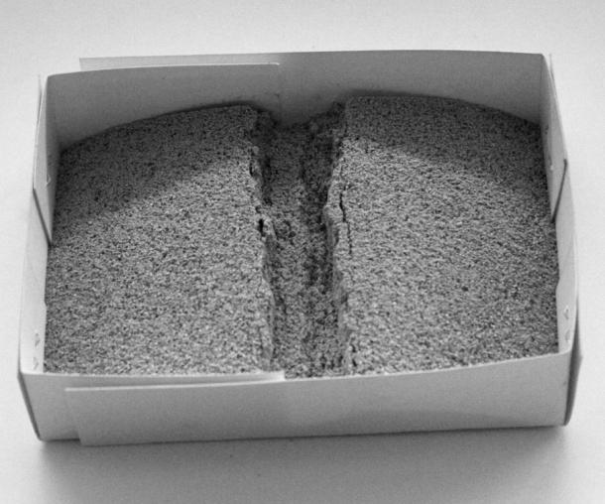
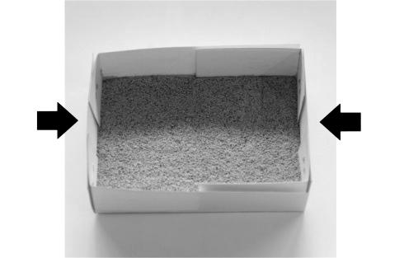
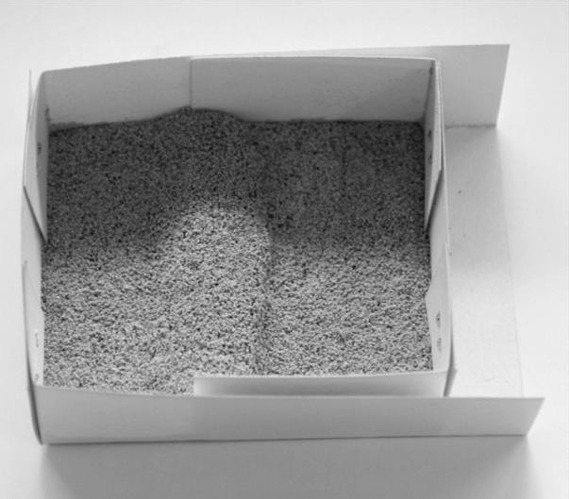
How are faults formed?

Slide 21
A fault is formed when…
…the ground is squeezed by forces from inside the Earth
TENSION FORCES create faults by stretching or pulling rock layers from opposite directions

Slide 22
COMPRESSION FORCES create faults by pushing rock layers from opposite ends

Slide 23
How do faults produce quakes?

Slide 24
Activity 2: Stick ‘n’ slip

Slide 25
STICK ‘N’ SLIP
 | From the activity… | In real life…
STICK
SLIP

Slide 26
How do faults produce quakes?
Once friction is overcome, the ground suddenly moves and an earthquake occurs.
At first, the rocks are stuck together due to friction. Later, the rocks suddenly slip, generating an earthquake.
Every time a fault slips, the Earth quakes.

Slide 28
Assignment:
Create a fault model

