Slide 1
Motivational Activity
Review on Mirrors
Start here
Trace a line in between the stars. The line should not touch either stars.

Slide 2
Motivational Activity
Review on Mirrors
What property(ies) of the mirror helped you to complete the task?
What property(ies) of the mirror became a problem for you in completing the task?

Slide 3
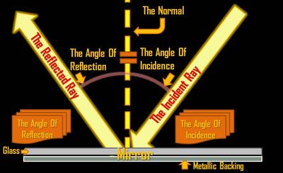
Flat Mirrors
Review on Mirrors
Flat/ Plane mirrors form images via reflection.

Slide 4
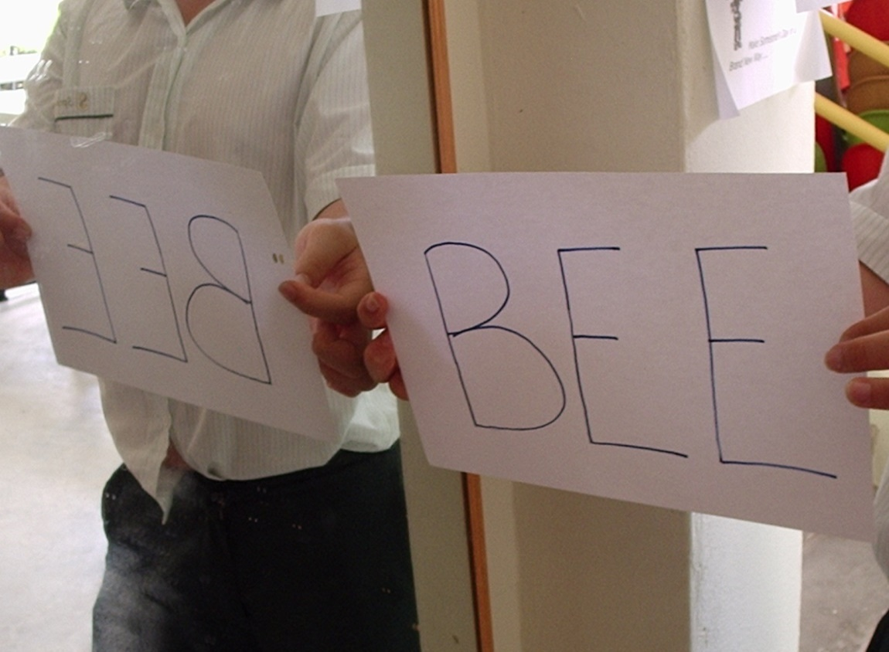
Flat Mirrors
Review on Mirrors
Object and Image have:
Same size
Same orientation
Equal distances from the mirror
The image in a plane mirror is laterally reversed.

Slide 5
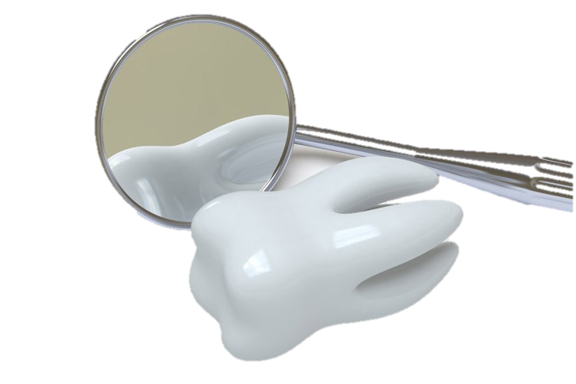
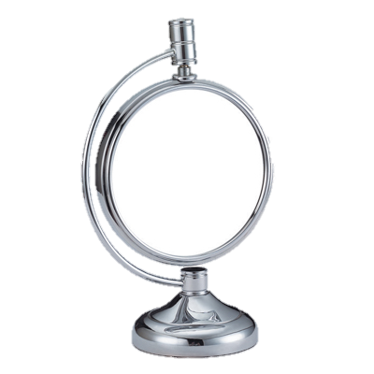
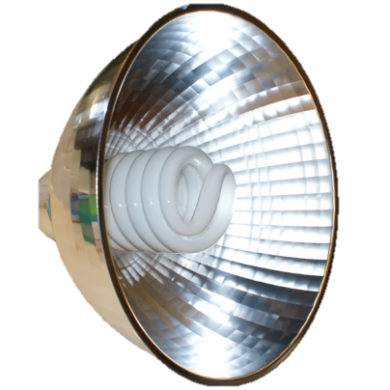
Curved Mirrors
Review on Mirrors
Concave mirror
converging mirror
images formed depends on the object location.
light reflectors
dentist’s mirror
make-up mirror

Slide 6
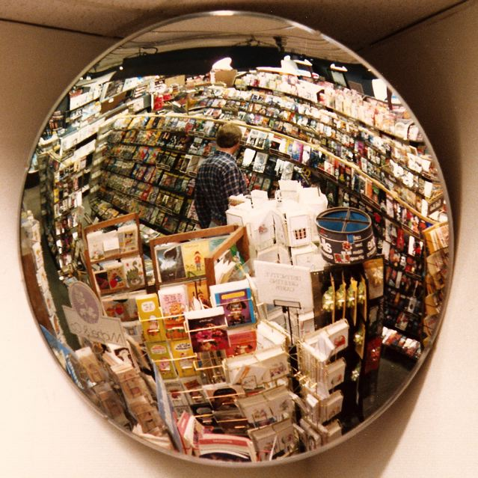
Curved Mirrors
Review on Mirrors
Convex mirrors
diverging mirror
images formed are always diminished and upright.
security mirror

Slide 7
Reflection of Light

Slide 8
Activity 7 (Part I)
Time Allotment: 20 minutes
You Can Be Magnified
Find the focal length (Procedure 1 to 3)
Locate and describe the image formed by a convex lens
Guide Questions: Q17 and Q18

Slide 9
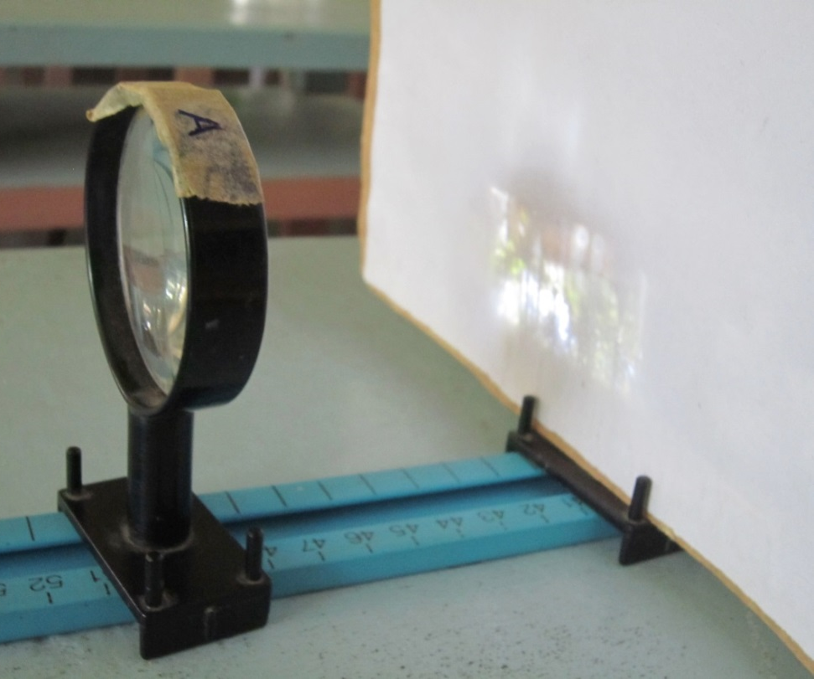
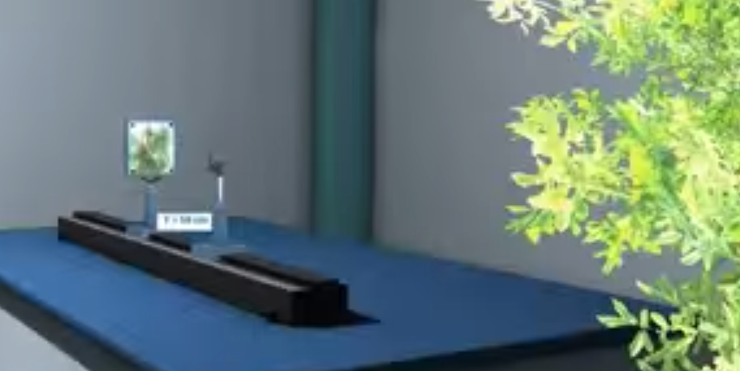
What is the focal length of the convex lens?
Q17
Answers vary depending on the lens used.
f = 10 cm

Slide 10
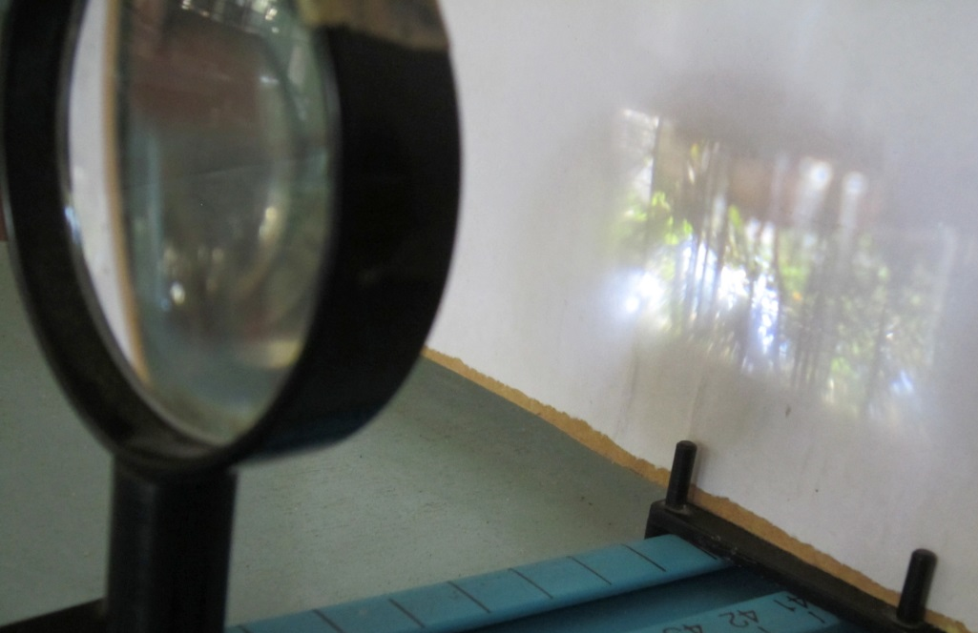
How do you describe the image formed if a distant object is used?
Q18
The image formed by a very distant object is inverted.
It is diminished.

Slide 11
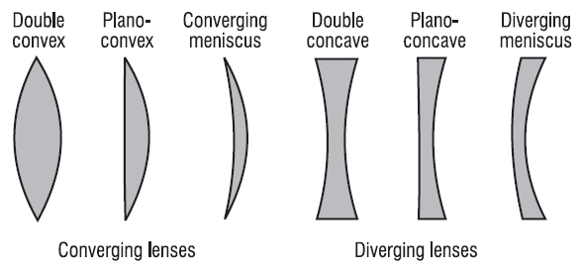
LENSES
A lens consists of a piece of glass or plastic, ground so that each of its two refracting surfaces is a segment of either a sphere or a plane.
http://www.physics.louisville.edu/cldavis/phys299/notes/lo_tl_typelens.jpg
DEPARTMENT OF EDUCATION

Slide 12
THE POWER OF A LENS
Which of the two lenses was able to magnify more?
What is the reason behind the difference in magnification?
activescienceworld.blogspot.com
DEPARTMENT OF EDUCATION / UP NISMED

Slide 13
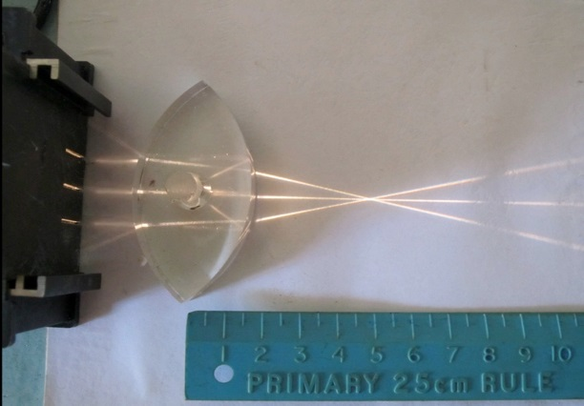
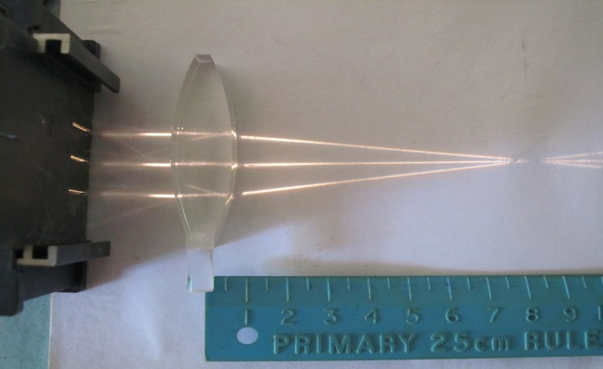
THE POWER OF A LENS
The power of a lens is its ability to bend light – the greater the power the greater the refraction of light. It is measured in diopter (dioptre). A lens is carefully shaped to control the bending of light.
activescienceworld.blogspot.com
DEPARTMENT OF EDUCATION / UP NISMED

Slide 14
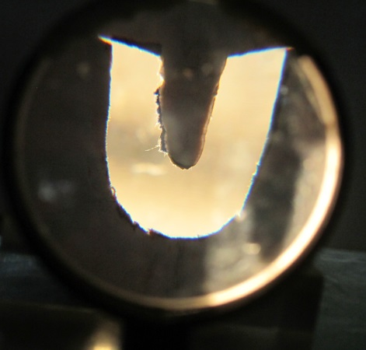
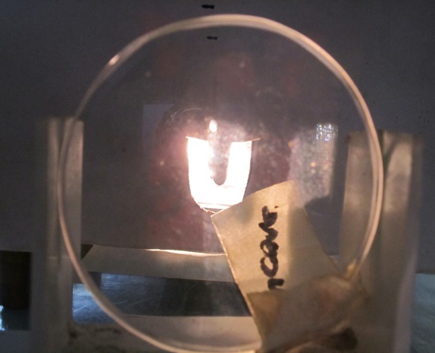
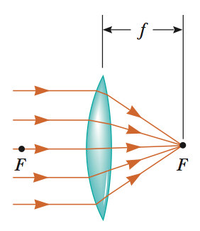
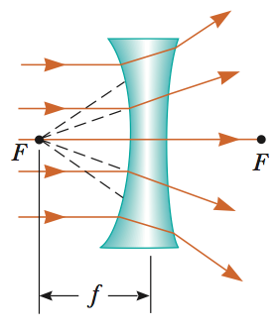
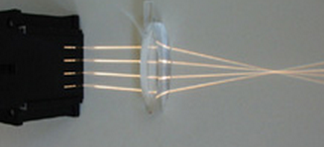
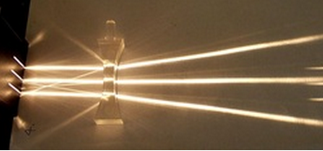
LENSES
Converging lenses have positive focal lengths and are thickest at the middle.
Diverging lenses have negative focal lengths and are thickest at the edges.
Focus, F
No REAL Focus
Focal length, f
DEPARTMENT OF EDUCATION / UP NISMED

Slide 15
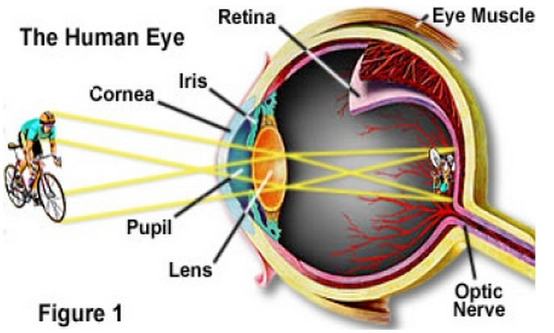
LENSES
ABSTRACTION
Lenses are commonly used to form images by refraction in optical instruments.
The human eye has a biconvex lens that enables it to form real images.
http://www.ssc.education.ed.ac.uk/courses/pictures/vmay082.jpg
DEPARTMENT OF EDUCATION / UP NISMED

Slide 16
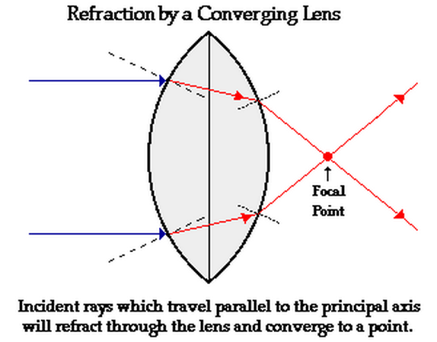
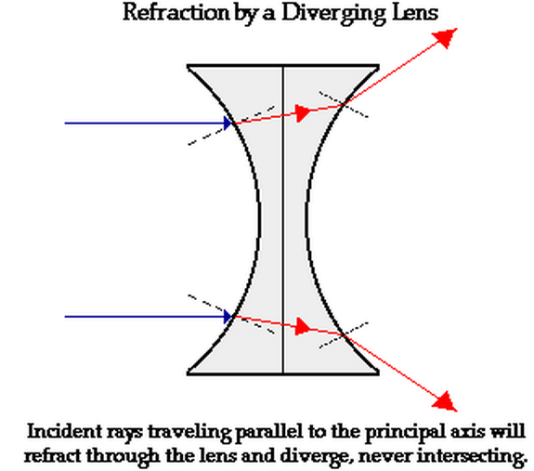
HOW A LENS REFRACTS LIGHT
From air into a more dense medium (plastic or glass), light bends towards the normal line.
From a more dense medium to a less dense medium, light bends away from the normal.
www.physicsclassroom.com
DEPARTMENT OF EDUCATION

Slide 17
Activity 7 (Part II)
Always measure from the middle
d_{image}
d_{object}
screen
lens
object
Determine how changing the object distance affects the image formed by a convex mirror.

Slide 18
Activity 7 (Part II)
Time Allotment: 15 minutes
Determine how changing the object distance affects the image formed by a convex mirror
Description | Distance from the lens to the object (cm) | Distance from the lens to the screen (cm)
Enlarged & Upright
Enlarged & Inverted
Reduced & Inverted
Guide Questions: Q19 and Q 20

Slide 19
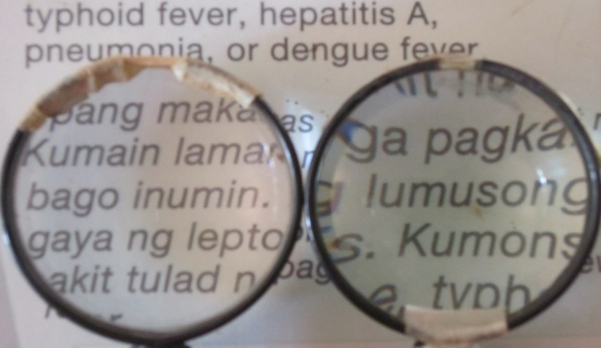
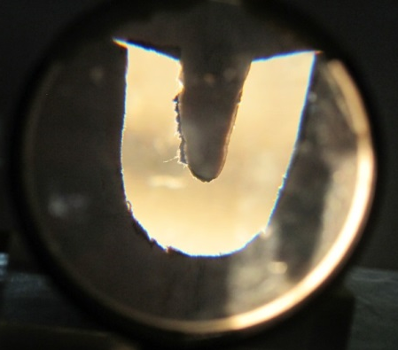
What kind of lenses are magnifying glass?
When a magnifying glass produces a sharp clear image, where is the object located in relation to the lens?
Q19
Convex lenses are used as magnifying glass.
To produce a magnified and upright image, the object must be placed very close to the lens – between the focal point and the lens.

Slide 20
Where should a magnifying glass be placed to produce an enlarged and upright image, closer to the eye or nearer to the object? Why?
Q20
A magnifying glass should be placed closer to the object than to the eye.
When light rays diverge from this location and strike the lens, the rays are still spreading out after passing through the lens. A new type of image called virtual image is formed.
It is an illusion formed by the way the light refracts through the lens. Image looks 3D and real but there is nothing where the image appears to be.

Slide 21
ACTIVITY 7
Expected Results
YoU Can Be Magnified
Description of Image | Distance from the Lens
 | Object (cm) | Eye (cm)
Answers may vary depending on the focal length of the lens used
Enlarged and upright | p < f | q > f
Enlarged and inverted | f < p < 2f | q > 2f
Reduced and inverted | p >2f | f < q <2f
DEPARTMENT OF EDUCATION / UP NISMED

Slide 22
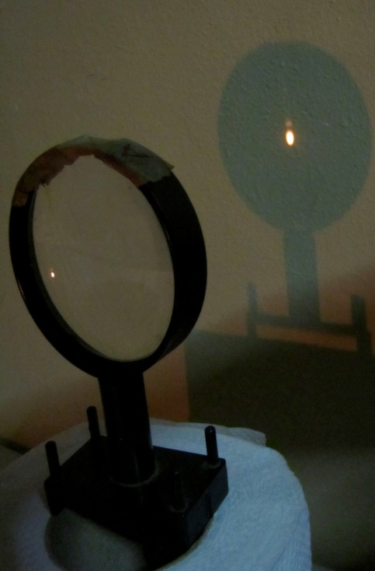
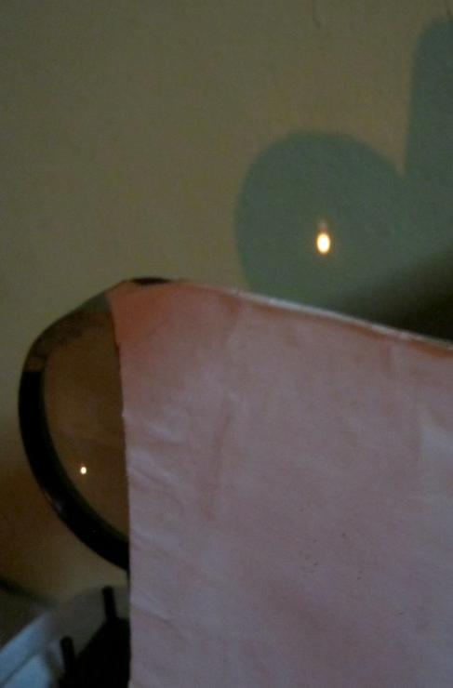
HALF A LENS
When you cover half of a lens, you get a fainter image. (You are cutting out half the light rays – only half reach the image point giving only half the intensity, but they still produce the entire image.
http://www.ssc.education.ed.ac.uk/courses/pictures/vmay082.jpg
DEPARTMENT OF EDUCATION / UP NISMED

Slide 23
LENSES:
THE “IMAGE BUILDERS”
The Anatomy of a Lens
2f = R
For a thin lens,
focus to lens surface = focus to the center
(negligible difference)
www.physicsclassroom.com
DEPARTMENT OF EDUCATION / UP NISMED

Slide 24
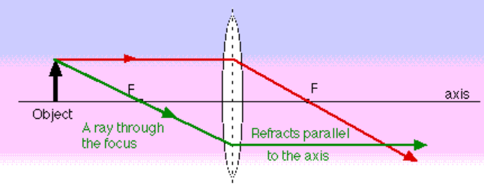
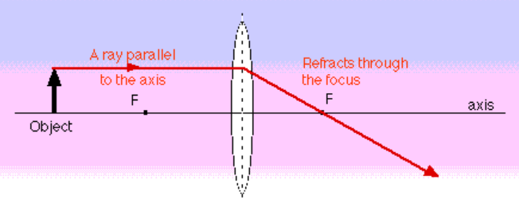
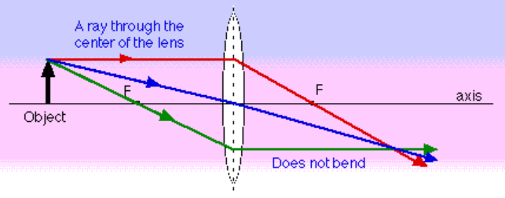
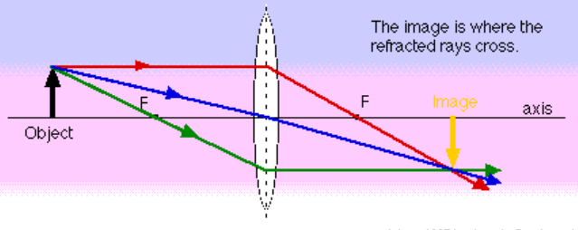
LENSES:
THE “IMAGE BUILDERS”
Ray Tracing Method
Ray Diagram for a Convex Lens
P-F Ray (Principal Ray/ Parallel Ray)
F-P Ray (Focal Ray)
V Ray (Vertex Ray)
http://www.gcsescience.com/Convex-Lens-Focal-Point-Length.gif
DEPARTMENT OF EDUCATION / UP NISMED

Slide 25
LENSES: THE “IMAGE BUILDERS”
Convex Lens: Location, Orientation, Size and Type
 | Location of Object | Image
 |  | Location | Orientation | Size | Type
C | beyond 2F
 | at 2F
B | between 2F & F
 | at F
A | between F & lens
DEPARTMENT OF EDUCATION / UP NISMED

Slide 26
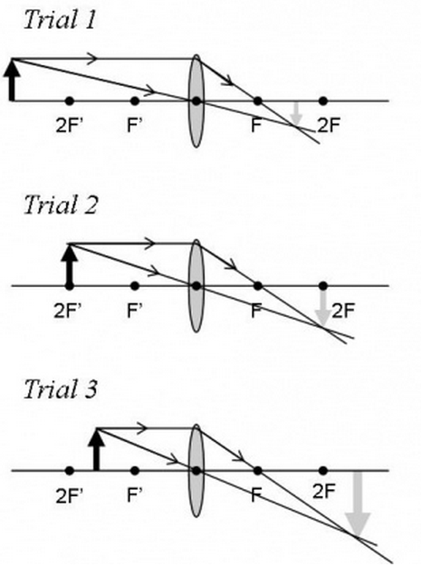
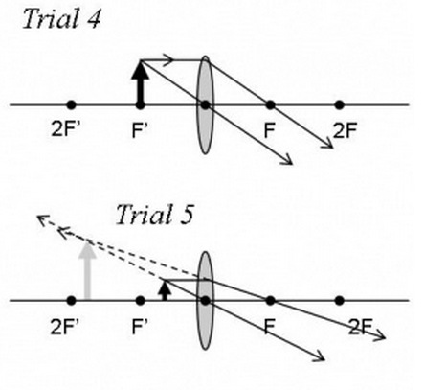
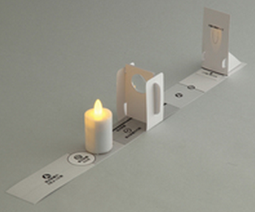
LENSES: THE “IMAGE BUILDERS”
Convex Lens: Location, Orientation, Size and Type
http://scioly.org/wiki/images/thumb/e/e9/Image_Location_Lenses.jpg/600px-Image_Location_Lenses.jpg
DEPARTMENT OF EDUCATION / UP NISMED

Slide 27
LENSES: THE “IMAGE BUILDERS”
Convex Lens: Location, Orientation, Size and Type
 | Location of Object | Image
 |  | Location | Orientation | Size | Type
C | beyond 2F | between 2F & F | inverted | reduced | real
 | at 2F | at 2F | inverted | the same | real
B | between 2F &F | > 2F | inverted | enlarged | real
 | at F | no image
A | between F & lens | behind lens | upright | enlarged | virtual
not applicable
DEPARTMENT OF EDUCATION / UP NISMED

Slide 28
LENSES: THE “IMAGE BUILDERS”
Ray Diagram for a Concave Lens
P-F Ray (Principal Ray/ Parallel Ray)
V Ray (Vertex Ray)
F-P Ray (Focal Ray)
http://www.gcsescience.com/Concave-Lens-Ray-Diagram-Divergent.gif
DEPARTMENT OF EDUCATION / UP NISMED

Slide 29
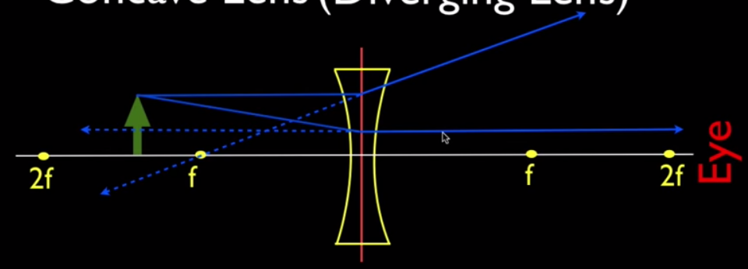
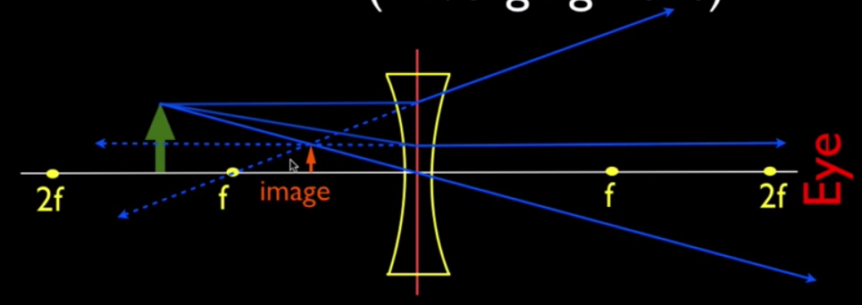
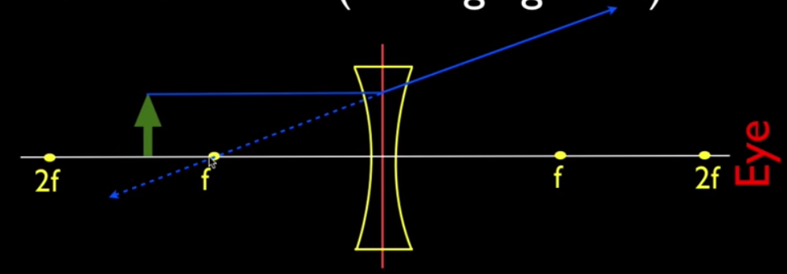
LENSES: THE “IMAGE BUILDERS”
Ray Diagram for a Concave Lens
P-F Ray (Principal Ray/ Parallel Ray)
V Ray (Central Ray)
F-P Ray (Focal Ray)
https://www.youtube.com/watch?v=c2GFG6cvPew
DEPARTMENT OF EDUCATION / UP NISMED

Slide 30
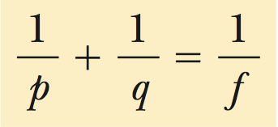
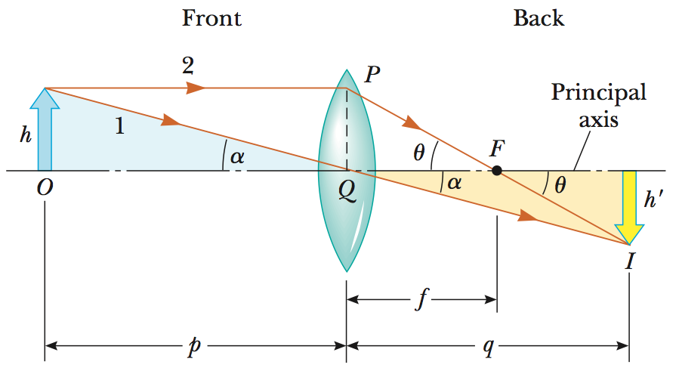
THE THIN LENS EQUATION
p = object distance (do)
q = image distance (di)
Vertical angles of two intersecting lines are congruent.
DEPARTMENT OF EDUCATION / UP NISMED

Slide 31
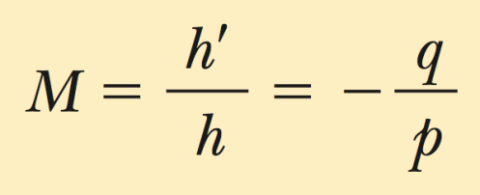
THE THIN LENS EQUATION
Magnification Equation
h = object height
h’ = image height
DEPARTMENT OF EDUCATION / UP NISMED

Slide 32
LENSES
APPLICATION
Object is | Image is | Application
Rays from infinity | Focused at a point (focus) → point image | Starting a fire by focusing the sun’s rays
beyond 2F | between 2F & F, inverted, reduced & real | Lens of eye Camera lens
at 2F | at 2F, inverted, same size and real | Photocopy machine
between 2F &F | > 2F, inverted, enlarged and real | Slide projector
at F | no image formed (parallel rays → beam of light) | Searchlight, lighthouse
between F & lens | behind lens, upright, enlarged & virtual | Magnifying glass, eyepiece of a microscope, binoculars
https://www.youtube.com/watch?v=c6mLLaqLdvg
DEPARTMENT OF EDUCATION / UP NISMED

Slide 33
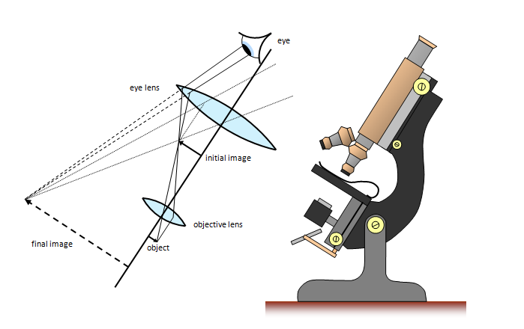
LENSES
APPLICATION
Image Formation In A Compound Microscope
www.schoolphysics.co.uk
DEPARTMENT OF EDUCATION / UP NISMED

Slide 34
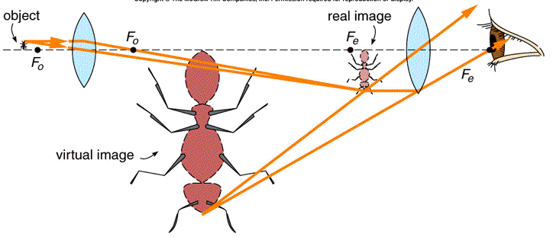
LENSES
APPLICATION
Image Formation In A Compound Microscope
http://bolvan.ph.utexas.edu/~vadim/Classes/2014f/Microscope.gif
DEPARTMENT OF EDUCATION / UP NISMED

Slide 35
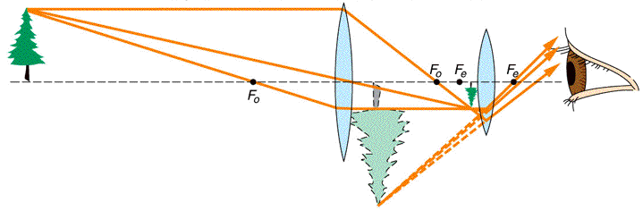
LENSES
APPLICATION
Image Formation In A Telescope
http://bolvan.ph.utexas.edu/~vadim/Classes/2014f/Telescope.gif
DEPARTMENT OF EDUCATION / UP NISMED

Slide 36
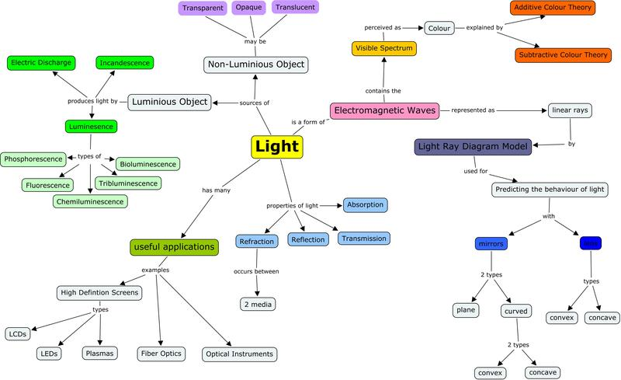
LIGHT
Concept Map
DEPARTMENT OF EDUCATION / UP NISMED

Slide 37
LIGHT: MIRRORS & LENSES
Science Process Skills
The science process skills targeted are as follows:
Observing, making predictions, and formulating hypothesis about light by manipulating materials to conduct an experiment
Collecting, recording and interpreting data
Developing vocabulary to communicate the results of their findings
Displaying information by means of graphic illustrations
Applying math rules or formulas to calculate quantities
DEPARTMENT OF EDUCATION

Slide 38
Post - Assessment
TRUE or FALSE: The Big M
Blocking part of the lens surface would block the corresponding part of the image.
The size of the image depends on the size (diameter) of the lens.
The purpose of the surface is to capture the real image so it can be seen. Without the surface, there is no image.
Light passes straight through various transparent materials.
DEPARTMENT OF EDUCATION
Painting by Edouard Manet

Slide 39
Remembering
ASSESSMENT
Juan’s grandfather wants to read the latest newspaper. Which of the following must Juan give his lolo to help his lolo read the articles with ease?
Concave lens C. Flat Mirror
Convex lens D. Curved Mirror
Where must a candle flame be placed to produce an image that is upright and magnified?
Inside the focus C. At the focus
Outside the focus D. Anywhere in front of the
lens
DEPARTMENT OF EDUCATION / UP NISMED

Slide 40
Remembering
ASSESSMENT
The focal length of lens A is 50 cm. What is the power of this lens?
50 D C. 0.5 D
2 D D. 0.02 D
Describe the image formed by the human eye.
Magnified and virtual C. Diminished and virtual
Magnified and real D. Diminished and real
DEPARTMENT OF EDUCATION / UP NISMED

Slide 41
Applying
ASSESSMENT
LOCATE MY IMAGE
A lens has a focal length of 10 cm. When an object is placed 40 cm from the lens, it forms an image that is inverted and real. Using the ray tracing method and the thin lens equation, determine the location and size of this real image.
GUESS WHERE I GO
Construct the ray diagrams for an object placed at different locations in front of a concave/ convex lens.
DEPARTMENT OF EDUCATION / UP NISMED

Slide 42
Understanding
ASSESSMENT
FIND MY MATCH!
Match the following lens arrangements with their corresponding applications.
Item | Lens Arrangement | (Technological) Application
___1. | Object at Infinity | A. Searchlight; Lighthouse
___2. | Object Beyond 2F | B. Photocopy Machine
___3. | Object at 2F | C. Starting Fire by Focusing Sun’s rays
___4. | Object Between 2F and F | D. Binoculars
___5. | Object at F | E. Lens of Eye
___6. | Object Between F & Lens | F. Slide Projector
DEPARTMENT OF EDUCATION / UP NISMED

Slide 43
Creating
ASSESSMENT
MAKING AN IMPROVISED OPTICAL DEVICE
The Pinhole Camera
Task: Construct a pinhole camera and explain the factors that affect the image on the screen.
Materials:
Illustration board, black cartolina, pin, glue, cutter, ruler, clear lamp, scissors
Procedure:
With your group mates, and using the materials given, design and construct an improvised camera based on the information gathered from different resources.
DEPARTMENT OF EDUCATION / UP NISMED

Slide 44
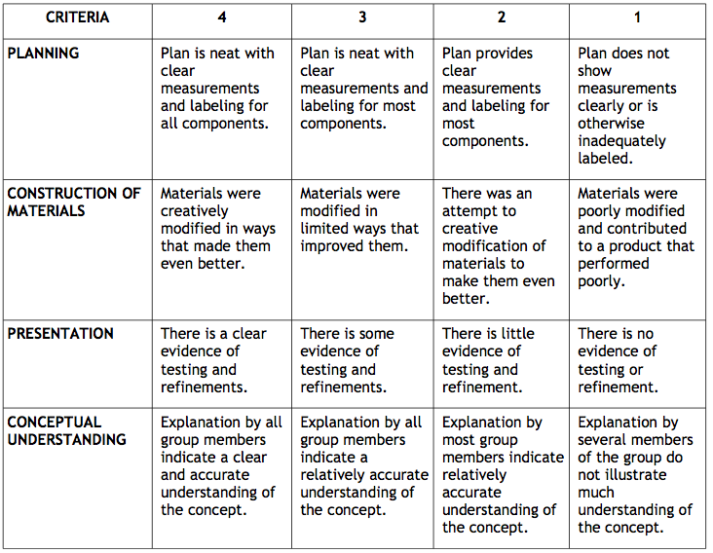
Creating
ASSESSMENT
BEAM Science Learning Guide “Bouncing Light”
DEPARTMENT OF EDUCATION / UP NISMED

